Slide 1
CloudFormation Guard 2.0
Amit Kumar Gupta

Slide 2
Agenda – Guard 2.0
Overview
Windows Installation
Template Validation
Example - 1
Example - 2
Example - 3
Git-Hub URL

Slide 3
Guard 2.0 – Overview
AWS CloudFormation Guard 2.0
Release Date – 17 May 2021
Using Guard 2.0, we can write policy rules for any JSON- and YAML-formatted file like CloudFormation templates, Kubernetes configurations (Newly Added) and Terraform JSON configurations (Newly Added).
Guard is an open-source command line interface tool which provides a simple, domain-specific language (DSL) to write policy rules and validate their structured hierarchical JSON- and YAML-data against those rules.
For example → we can create rules to ensure that they always model encrypted Amazon S3 buckets in their CloudFormation templates.

Slide 4
Guard 2.0 – Windows Installation
Windows 10
Step – 1 → Install the version of Microsoft Visual C++ Build Tools 2019
https://visualstudio.microsoft.com/downloads/#build-tools-for-visual-studio-2019
Run → vs_buildtools__1178216595.1602332321.exe
Step – 2 → Install – Windows 10 SDK
Step – 3 → Install rustup
https://forge.rust-lang.org/infra/other-installation-methods.html#other-ways-to-install-rustup
Run → rustup-init.exe
Step – 4 → Install cfn-guard
Run → cargo install cfn-guard
Step – 5 → Test guard version
Run → cnf-guard –V
Output → cfn-guard 2.0

Slide 5
Guard 2.0 – Template Validation
Template Name – Example-Volume.yaml
Ruleset Name – Example-Volume.rules
Guard 1.0 → Using ‘check’ command
cfn-guard check -t Example-Volume.yaml -r Example-Volume.rules
Guard 2.0 → Using ‘validate’ command
cfn-guard validate -d Example-Volume.yaml -r Example-Volume.rules

Slide 6
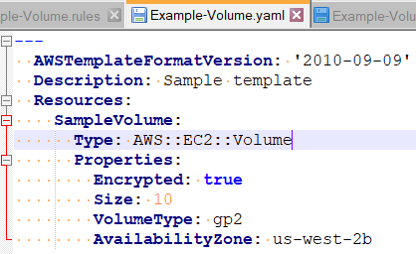
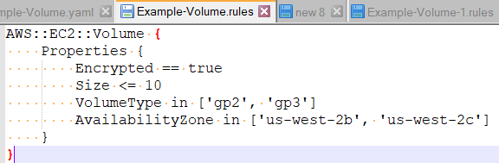
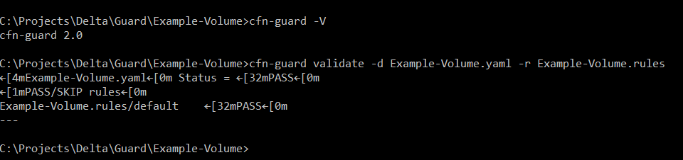
Guard 2.0 – Example - 1
Template Name – Example-Volume.yaml
Ruleset Name – Example-Volume.rules

Slide 7
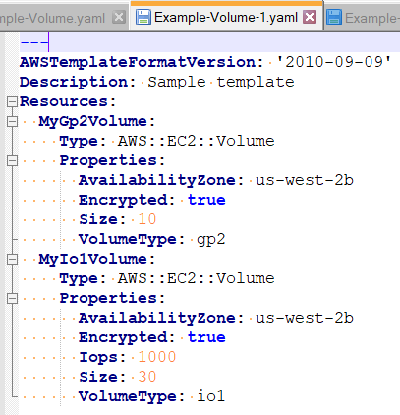
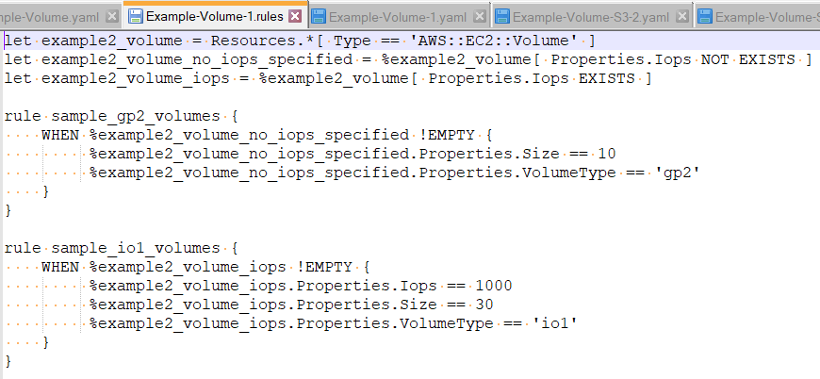
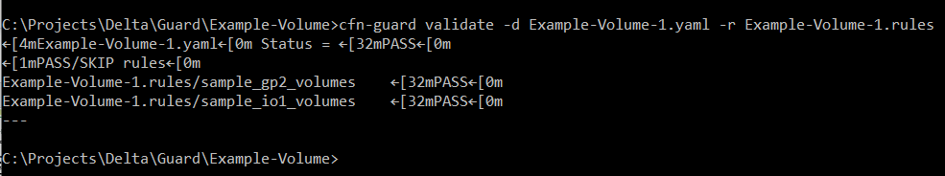
Guard 2.0 – Example - 2
Template Name – Example-Volume-1.yaml
Ruleset Name – Example-Volume-1.rules

Slide 8
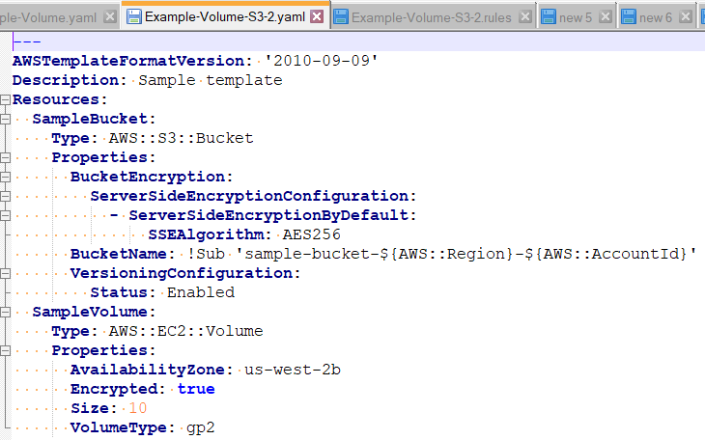
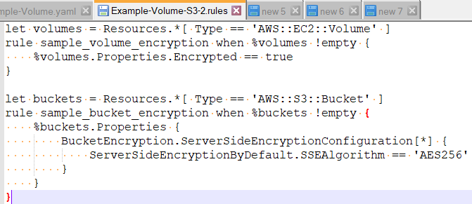
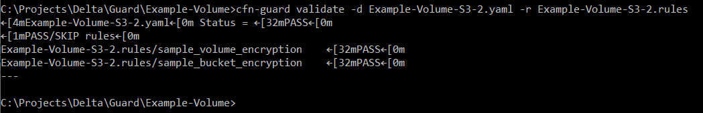
Guard 2.0 – Example - 3
Template Name – Example-Volume-S3-2.yaml
Ruleset Name – Example-Volume-S3-2.rules

Slide 9
Guard 2.0 – GitHub URL
GitHub URL
https://github.com/amit873/GloudFormation_Guard_2.0.git

Slide 10
Thanks

